Slide 1
Precise Analysis

Slide 2
USE CLASS DIAGRAM

Slide 3
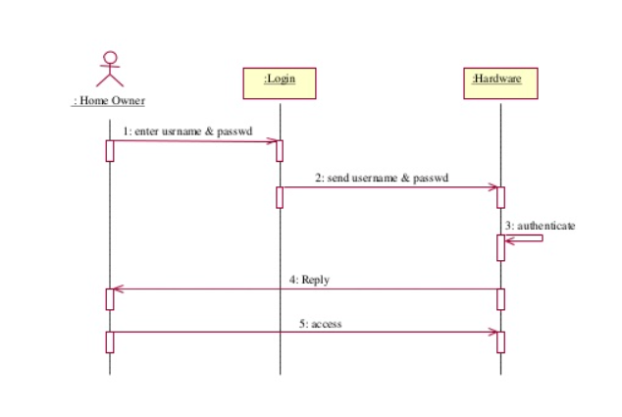
SEQEUNCE DIAGRAM FOR LOGIN

Slide 4
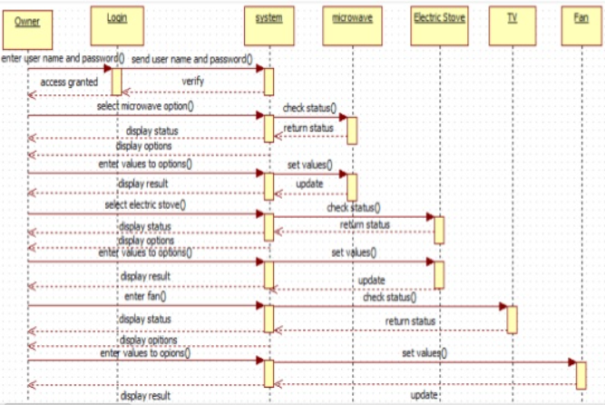
SEQEUNCE DIAGRAM FOR HOME APPLIANCES

Slide 5
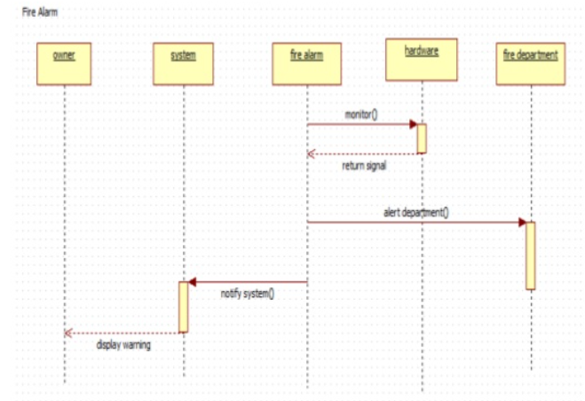
SEQUENCE DIAGRAM FOR FIRE ALARM

